Slide 1
CSS Units
Muhammad Naeem Akhtar

Slide 2
What is a viewport?
A viewport represents the area in computer graphics being currently viewed.
In web browser terms, it is generally the same as the browser window, excluding the UI, menu bar, etc. That is the part of the document you are viewing.
Simply, the viewport is basically the part of the document that is currently visible.

Slide 3
Viewport continue…
On larger monitors where applications aren't necessarily full screen, the viewport is the size of the browser window.
On most mobile devices and when the browser is in fullscreen mode, the viewport is the entire screen.
In full screen mode, the viewport is the device screen, the window is the browser window, which can be as big as the viewport or smaller, and the document is the website, which can be much taller or wider than the viewport.

Slide 4
What is CSS value or Data type?
When you see something in CSS referred to as a data type, it is really just a fancy way of saying value type.
The term value refers to any particular expression supported by a value type that you choose to use.
A value type in CSS is a way to define a collection of allowable values.
For example:
integer (whole number),
number(10.2, -1.9),
dimension (90deg, 10px, etc.),
and percentage (40%)

Slide 5
Lengths
The numeric type you will come across most frequently is length.
There are two types of lengths used in CSS
— relative and absolute.
It's important to know the difference in order to understand how big things will become.

Slide 6
Absolute length units
The following (next slide) are all absolute length units.
They are not relative to anything else, and are generally considered to always be the same size.
Most of these units are more useful when used for print, rather than screen output.
For example, we don't typically use cm (centimeters) on screen. The only value that you will commonly use is px (pixels).
Notes:
Most of these units are more useful when used for print, rather than screen output. For example, we don't typically use cm (centimeters) on screen. The only value that you will commonly use is px (pixels).

Slide 7
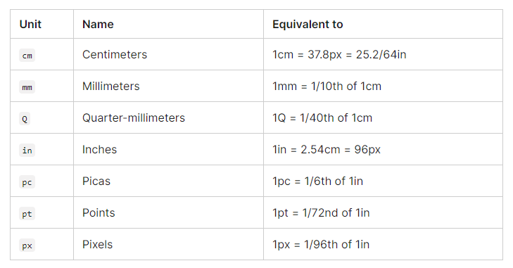
Absolute length units

Slide 8
Practice
See example FixUnits.html

Slide 9
Relative length units
Relative length units are relative to something else, perhaps the size of the parent element's font, or the size of the viewport.
The benefit of using relative units is that with some careful planning you can make it so the size of text or other elements scales relative to everything else on the page.
Some of the most useful units for web development are listed in the table below (next slide)

Slide 10
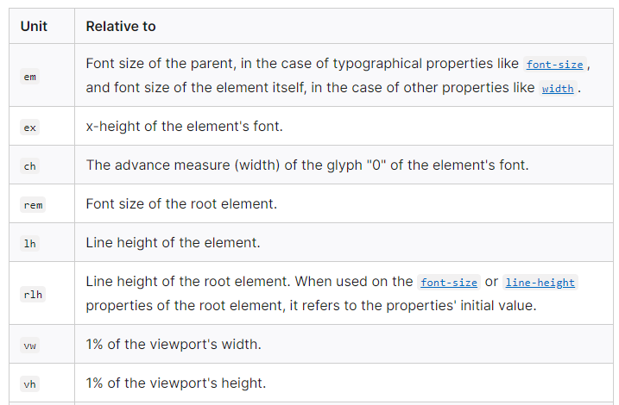
Relative length units

Slide 11
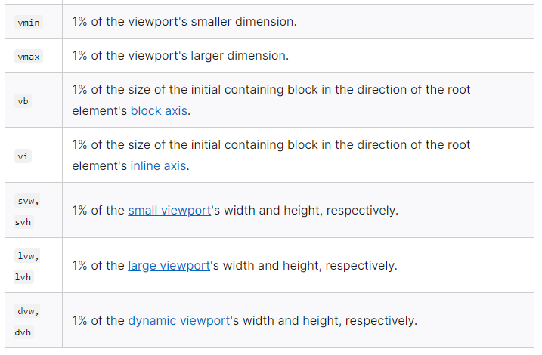
Relative length units

Slide 12
Practice
See example RelativeUnits.html

Slide 13
Discussion on units 1. em
The CSS em unit gets its name from a typographical unit. In typography,
the term em "was originally a reference to the width of the capital M in the typeface and size being used".
When used with the font-size property, em inherits the font-size from its parent element:
See example emfontsize.html and check computed size
If em is used with another property like width, em is calculated using the size of the targeted element.
See example emwidthheight.html and check computed size
Notes:
If em is used with another property like width, em is calculated using the size of the targeted element.

Slide 14
2. rem
This relative unit is not affected by the size or setting of a parent element, and is instead based on the root of the document.
What is root element in html document?
P {
font-size: 1.2rem
}
In most browsers, the default font size is 16, so the font-size of html elements is 16px. So in this case, p is 20px (16 * 1.2).
But if a user changes their browser's default font size, then the font-size of p will scale up or down accordingly.
See remexample.html
Notes:
For websites, the root of the document is the html element. In most browsers, the default font size is 16, so the font-size of html elements is 16px. So in this case, p is 20px (16 * 1.25).

Slide 15
3. %
Percentages, or the percent size relative to the parent's size:
div {
width: 400px;
}
div p {
width: 75%;
}
See percentageexample.html
Notes:
div { width: 400px; } div p { width: 75%; }

Slide 16
4. vw(view width)
It is 1% of the viewport width.
For example
Body {
width=100vw;
}
Since the body element is set to 100vw, or 100% of the viewport's width, it will take up the full width available to it.
So if you resize your browser to 690 pixels wide, then the body will take up all 690 pixels in width.
See example: vwexample.html
Notes:
Since the body element is set to 100vw, or 100% of the viewport's width, it will take up the full width available to it. So if you resize your browser to 690 pixels wide, then the body will take up all 690 pixels in width.

Slide 17
5. vh(view height)
View height. 1vh is 1% of the height of the viewport.
div{
height: 50vh;
}
The div will fill 50% of the viewport's height. So if the browser window is 900 pixels high, the height of the div will be 450 pixels.
See vhexample.html
Notes:
View height. 1vh is 1% of the height of the viewport.
div { height: 50vh; }
The div will fill 50% of the viewport's height. So if the browser window is 900 pixels high, the height of the div will be 450 pixels.

Slide 18
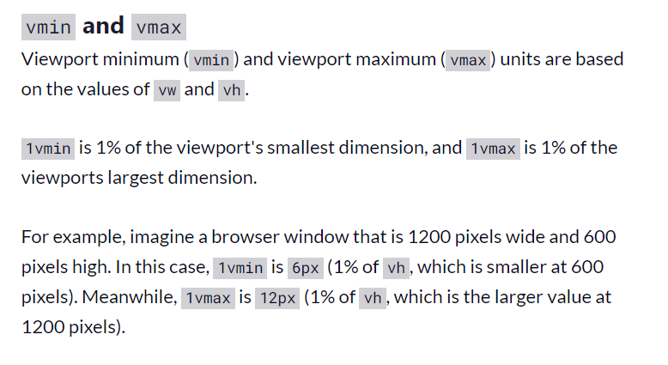
6. vmin and vmax

